Slide 1
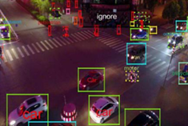
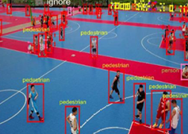
Object Detection for Autonomous Drones
Alpha
Mengfei Li (z5521416)
Yansong Zhu (z5470782)
Zhuoyu Wang (z5540457)
Zhaoyu Yan (z5452207)
Jiayang Jiang (z5319476)
Notes:
Good afternoon, everyone, I am mengfei LI. we are Group Alpha, and here is the order of our presentation . Out research focus on object detection for autonomous drones.

Slide 2
CONTENT
Problem Statement
Data Analysis
Method
Result
Discussion and Conclusion
Notes:
We will introduce our work in the following five main parts.

Slide 3
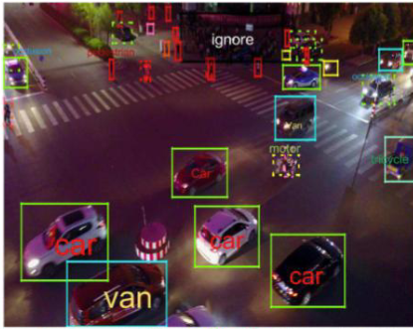
Motivation
Object detection: Identify and locate objects within images and videos
One of the core tasks in computer vision
Broad array of applications:
Image Understanding
Autonomous Driving
Video Surveillance
Retail and Warehousing
Medical image analysis
Facial recognition
…
Presenter: Mengfei Li (z5521416)
Notes:
AS one of the core tasks in computer vision, object detection has a wide range of applications

Slide 4
Problem Statement
Problem Description
Challenges: viewpoint changes, occlusion, varied scales
Impacts detection accuracy
Limitations of Current Method
Struggle with altitude, speed, and environment variations
Difficulty maintaining accuracy
Project Purpose
Build a robust object detection system for drones
Use VisDrone dataset for high accuracy and reliability in autonomous deployment
Presenter: Mengfei Li (z5521416)
Notes:
Object detection on autonomous drones presents unique challenges, including frequent changes in viewpoint, occlusion, and varied scale, which often impact detection accuracy.
Traditional detection methods struggle with these complexities, especially when drones operate at different altitudes ，speeds or diverse environments. Which is hard to maintain accuracy.

Slide 5
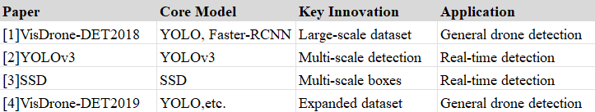
Literature Review
[1]. Visdrone-det2018: Vision Meets Drone Object Detection
Benchmark dataset for drone object detection.
Key Models: YOLO, Faster R-CNN
[2]. YOLOv3: Incremental Improvement
High-speed object detection.
Innovation: Multi-scale detection.
[3]. SSD: Single Shot MultiBox Detector
Default bounding boxes across scales and aspect ratios
Innovation: single-network design for faster processing
[4]. VisDrone-DET2019: Benchmark Update
Updated dataset with more challenging images.
Improved benchmarking for drone detection.
[1]. Zhu, Pengfei, Longyin Wen, Dawei Du, Xiao Bian, Haibin Ling, Qinghua Hu, Qinqin Nie et al. "Visdrone-det2018: The vision meets drone object detection in image challenge results." In
Proceedings of the European Conference on Computer Vision (ECCV) Workshops, pp. 0-0. 2018.
[2]. Redmon, Joseph, and Ali Farhadi. "Yolov3: An incremental improvement." arXiv preprint arXiv:1804.02767 (2018).
[3]. Liu, Wei, Dragomir Anguelov, Dumitru Erhan, Christian Szegedy, Scott Reed, Cheng-Yang Fu, and Alexander C. Berg. "SSD: Single Shot MultiBox Detector." In *Computer Vision – ECCV 2016*, pp. 21–37. Springer, Cham, 2016.
[4]. Du, Dawei, Pengfei Zhu, Longyin Wen, Xiao Bian, Haibin Lin, Qinghua Hu, Tao Peng et al. "VisDrone-DET2019: The vision meets drone object detection in image challenge results." In
Proceedings of the IEEE/CVF international conference on computer vision workshops, pp. 0-0. 2019.
Presenter: Mengfei Li (z5521416)
Notes:
Here are some of the main modeling methods used in relevant literature. We can see that in general situations, most of the literature uses the YOLO model, and also involves the fast-cnn and ssd model. Our subsequent research and improvement will focus on these three models.

Slide 6
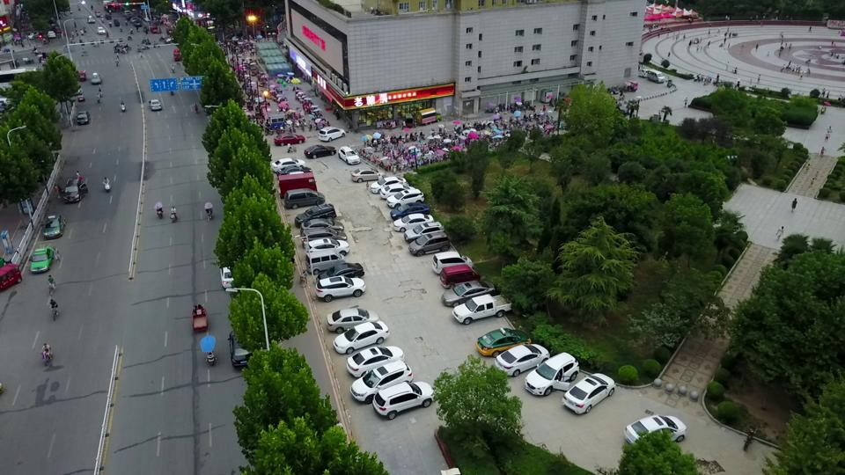
Dataset(s)
Visdrone-dataset/
images/
001.jpg
002.jpg
…
(x,y)
annotations/
001.txt
002.txt
…
Bounding box left | Bounding box top | Bounding box width | Bounding box height | Score | Object category | Truncation | Occlusion
684 | 8 | 273 | 116 | 0 | 0 | 0 | 0
406 | 119 | 265 | 70 | 0 | 0 | 0 | 0
255 | 22 | 119 | 128 | 0 | 0 | 0 | 0
…
Presenter: Mengfei Li (z5521416)
Notes:
The first two columns of the annotations file represents the coordinate of the predicted box top-left corner
The width heights of the predicted object bounding box
SCORE indicates the confidence of the predicted bounding box
the type of annotated object, (i.e., ignored regions (0), pedestrian (1),
people (2), bicycle (3), car (4), van (5), truck (6), tricycle (7), awning-tricycle (8), bus (9), motor (10),
TRUNCATION the degree of object parts appears outside a frame
(i.e., no truncation = 0 (truncation ratio 0%), and partial truncation = 1 (truncation ratio 1% °´ 50%)).=
OCCLUSION indicates the fraction of objects being occluded
(i.e., no occlusion = 0 (occlusion ratio 0%), partial occlusion = 1 (occlusion ratio 1% °´ 50%),
and heavy occlusion = 2 (occlusion ratio 50% ~ 100%)).

Slide 7
Dataset(s)
VisDrone
Consists of 8,599 images (6,471 for training, 548 for validation and 1,580 for testing)
Includes 10 object classes (‘pedestrain’, ‘people’, ‘bicycle’, ‘car’, ’van’, ‘trunk’, ‘tricycle’, ‘awning-tricycle’, ‘bus’, ‘motor’)
Presenter: Mengfei Li (z5521416)

Slide 8
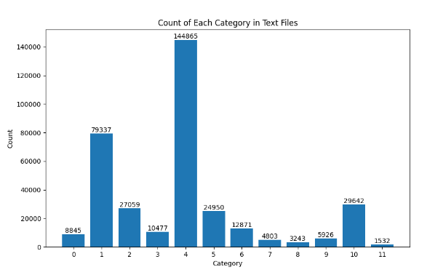
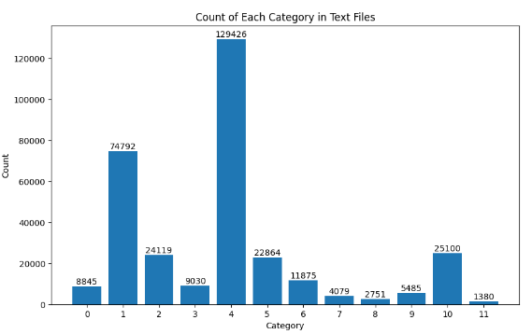
Data Analysis and Processing
TOO HIGH!
delete training sets
include over 90% Cate. 1 and 4
Initial dataset
(Before-6471 images)
Processed dataset
(After-4942 images)
Presenter: Yansong Zhu (z5470782)

Slide 9
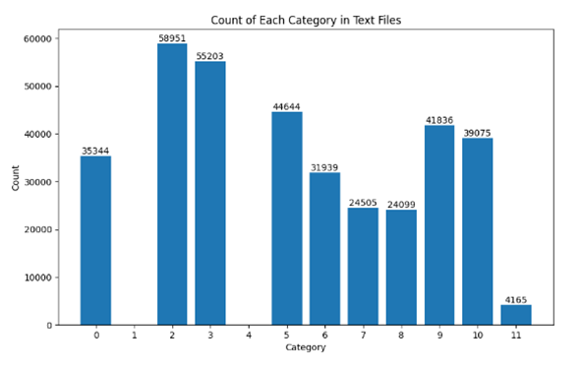
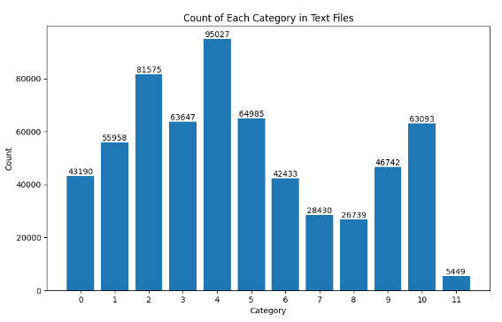
Data Analysis and Processing
TOO LOW!
Augmentate
34 datasets
merge
find high number of cate. 3,6,7,8,9 dataset relatively
(Before-4942 images)
1020 new dataset
(New-1020 images)
Merge 1020 and 4942 dataset
(After-5962 images)
Ignore 0, 11
Presenter: Yansong Zhu (z5470782)

Slide 10
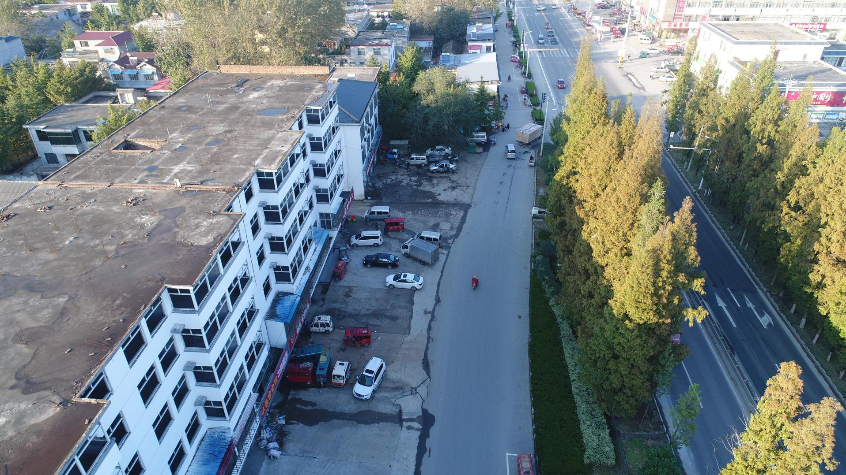
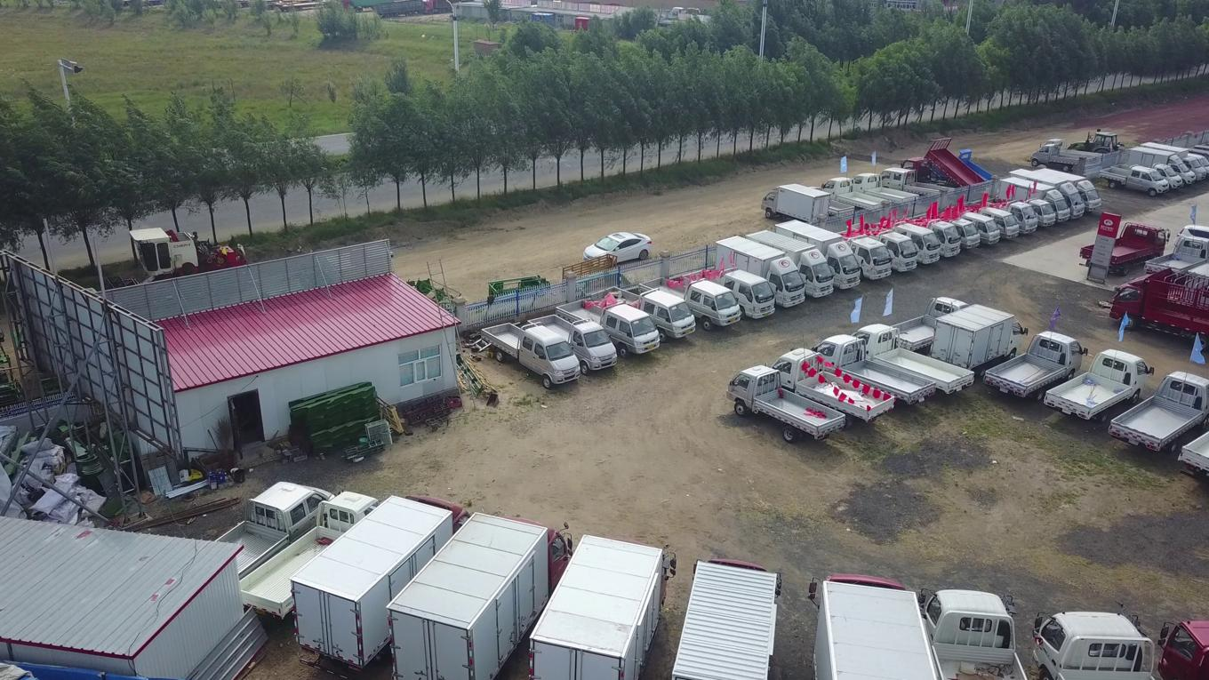
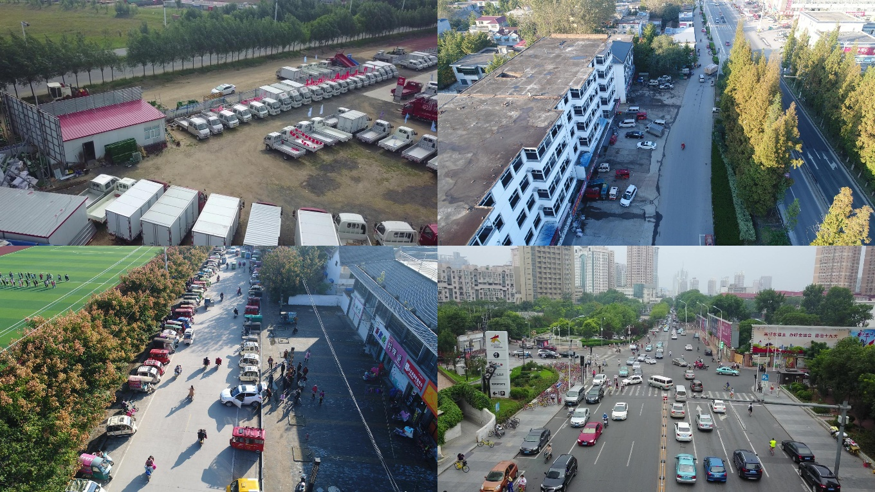
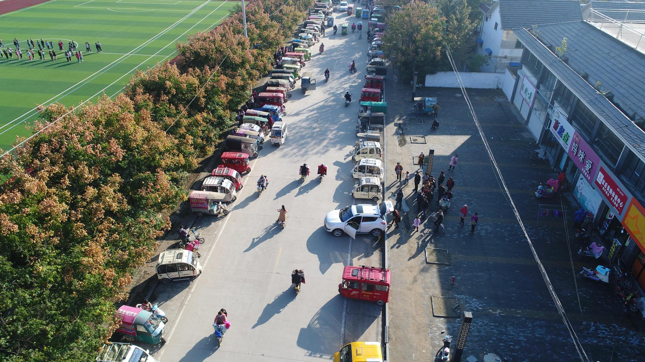
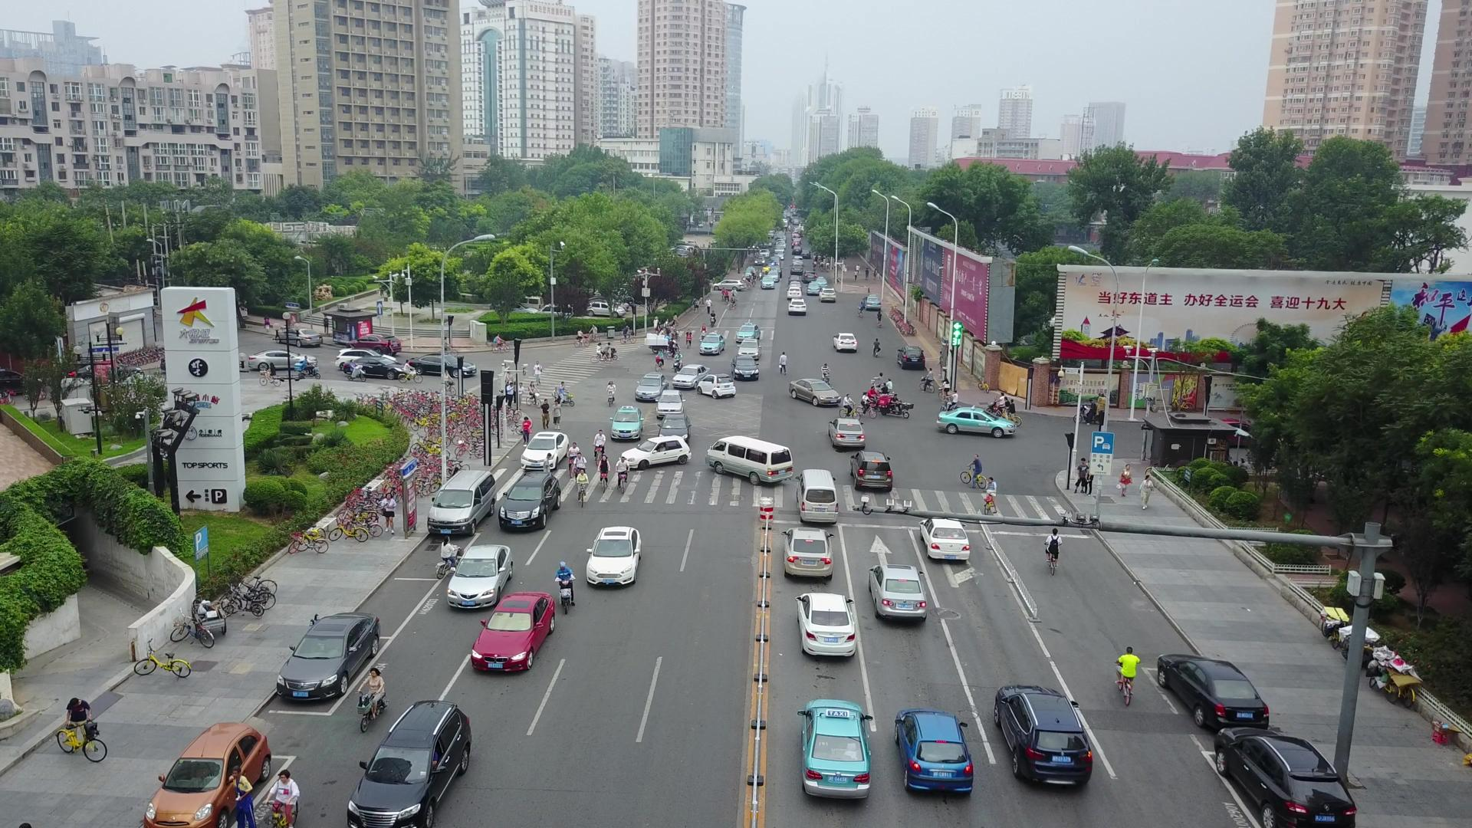
Data Analysis
Principle of Augmentation_Mosaic_update.py
Presenter: Yansong Zhu (z5470782)

Slide 11
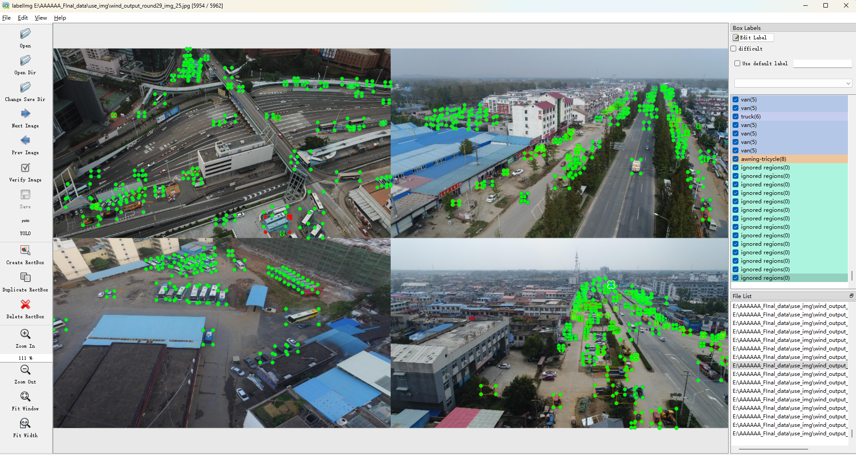
Data Analysis
Use labeling to prove annotations are correct after Augmentation
Presenter: Yansong Zhu (z5470782)

Slide 12
Data Analysis- Anontation
Visdrone-dataset/
Bounding box top left X | Bounding box top left Y | Bounding box width | Bounding box height | Score | Object category | Truncation | Occlusion
871 | 572 | 54 | 92 | 1 | 4 | 0 | 0
annotations/
001.txt
002.txt
…
Move
Object category | Bounding box top left X | Bounding box top left Y | Bounding box width | Bounding box height | Score | Truncation | Occlusion
4 | 871 | 572 | 54 | 92 | 1 | 0 | 0
Normalization- used for Augmentation
Object category | Bounding box top left X | Bounding box top left Y | Bounding box bottom right X | Bounding box bottom right Y | Score | Truncation | Occlusion
4 | 0.453646 | 0.52963 | 0.481771 | 0.614815 | 1 | 0 | 0
Presenter: Yansong Zhu (z5470782)

Slide 13
Data Analysis
Initial dataset
(Before-6471 images)
Processed dataset
(After-5962 images)
Presenter: Yansong Zhu (z5470782)

Slide 14
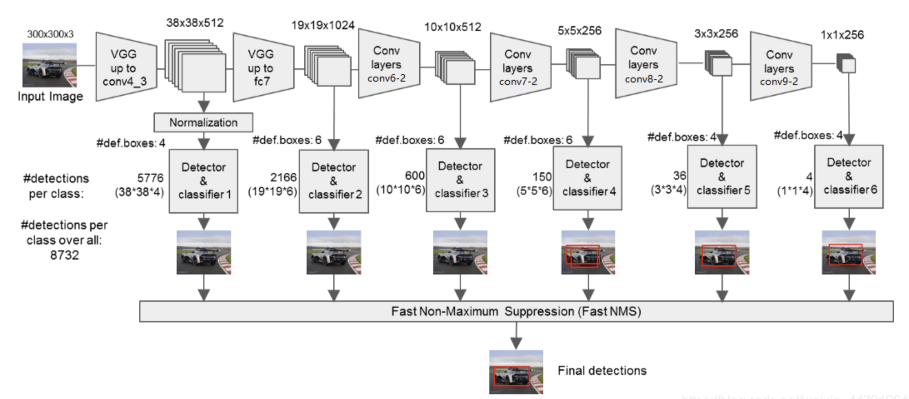
Methods—SSD
anchors_size = [21, 45, 99, 153, 207, 261, 315]
Presenter: Zhuoyu Wang

Slide 15
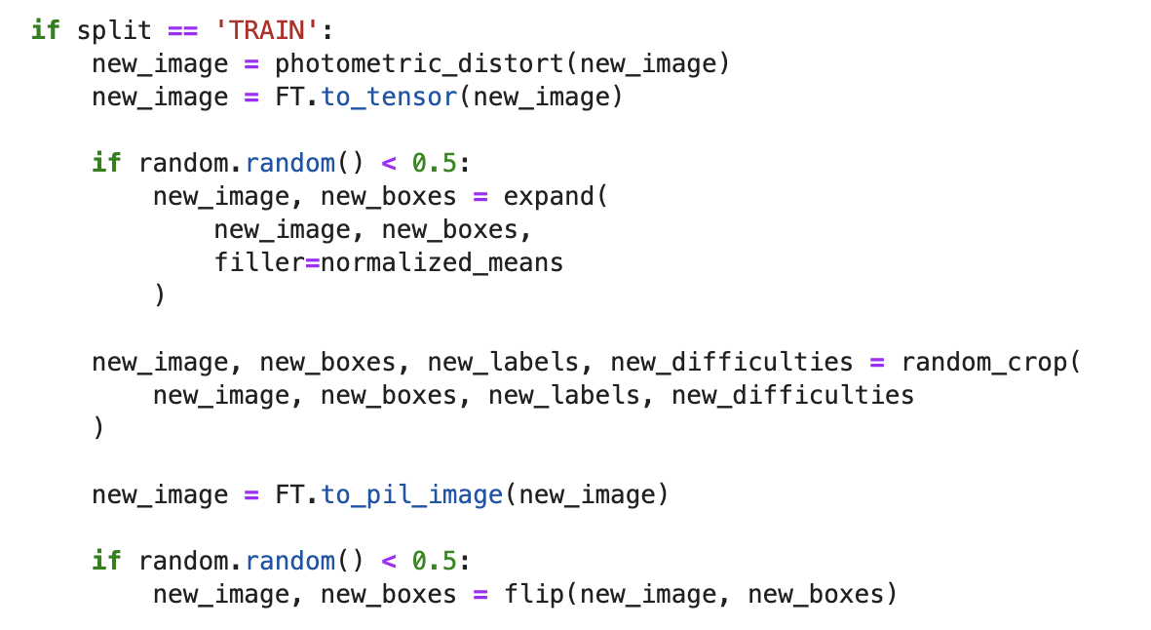
Methods—SSD
Data Augmentation:
Random cropping
Image expansion
Photometric distortion
Horizontal flipping
Presenter: Zhuoyu Wang

Slide 16
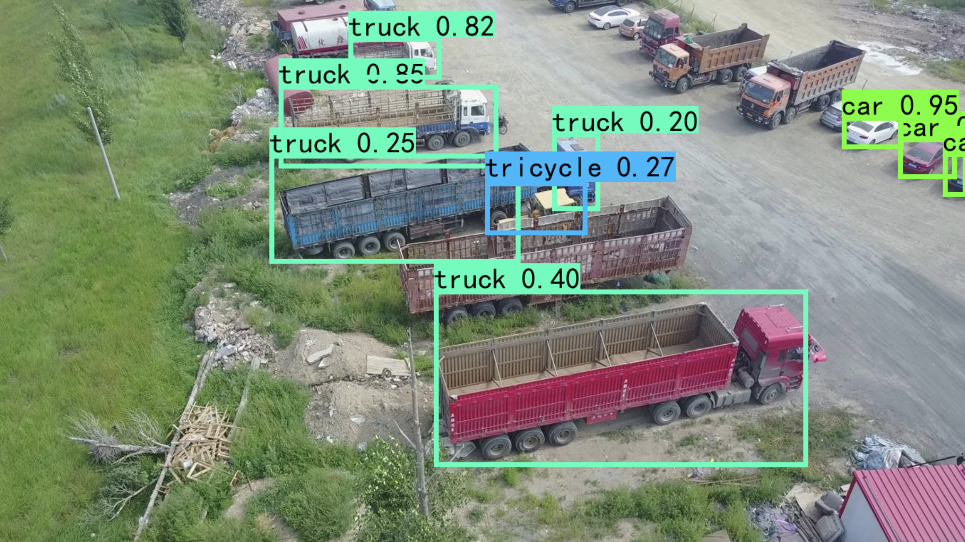
Prediction
Methods—SSD
The objects identified are correct.
Not all objects were identified
There are also limitations of SSD
Presenter: Zhuoyu Wang

Slide 17
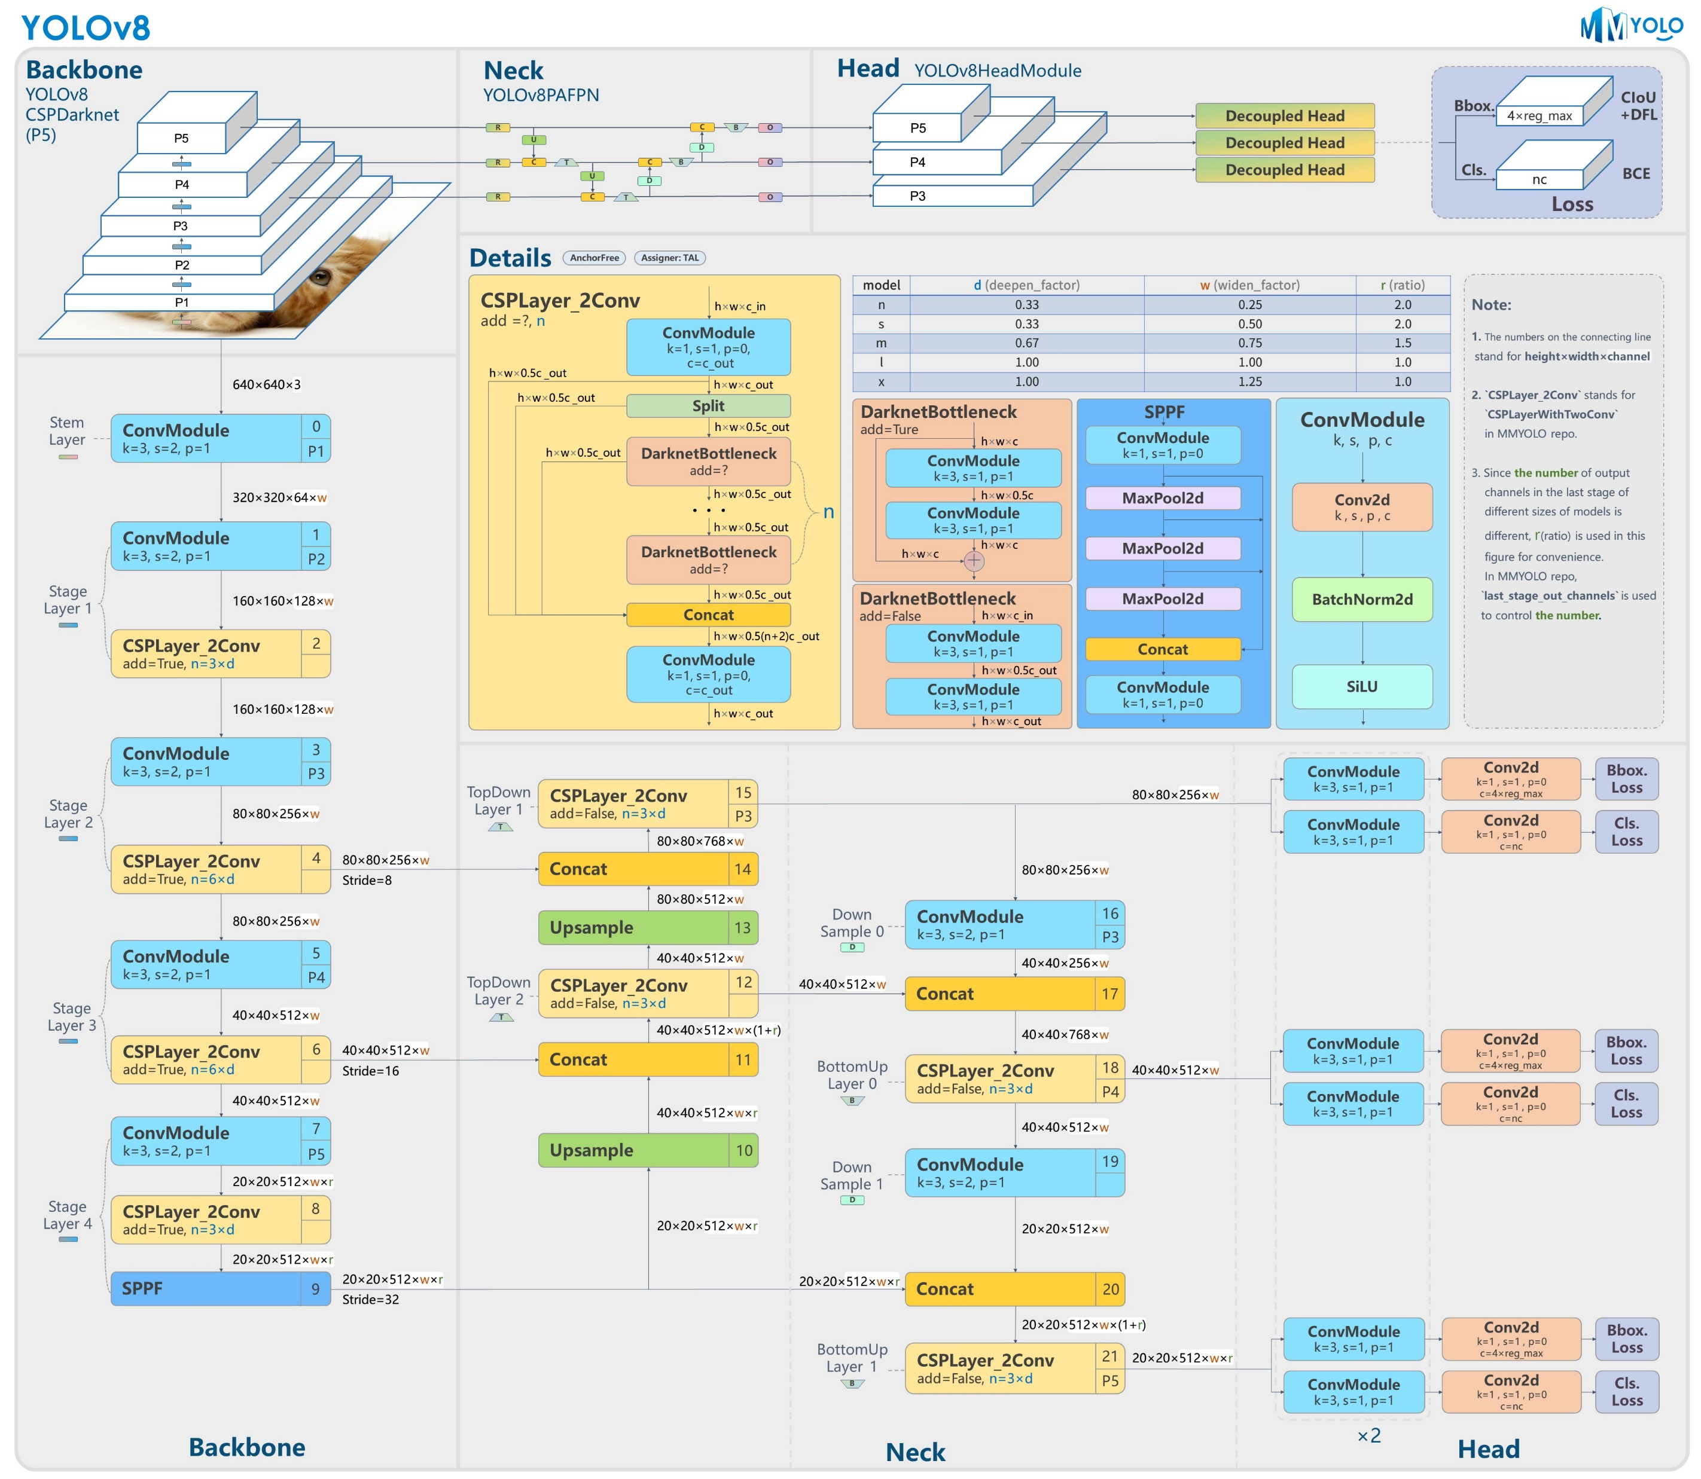
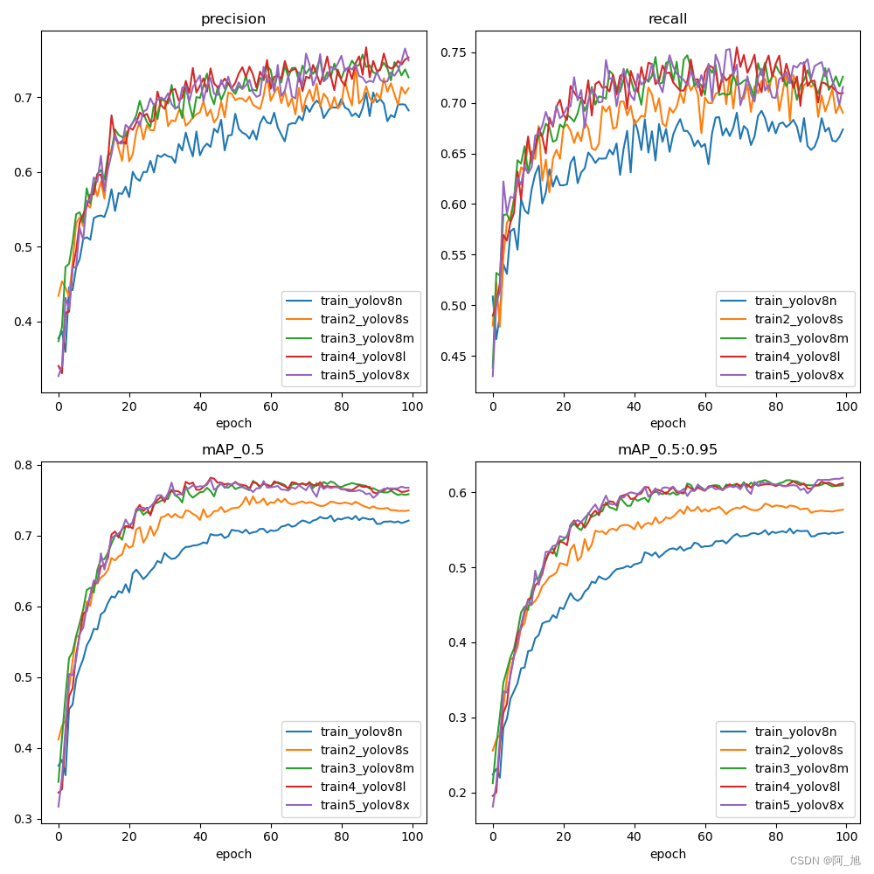
Methods—Yolov8
YOLOv8 is developed for object detection, segmentation and classification tasks.
Models | Deepen factor | Widen factor | Batch size | Param/Million | Weight size/MB | FLOPs/G
yolov8n | 0.33 | 0.25 | 256 | 3.1 | 6.3 | 8.2
yolov8s | 0.33 | 0.50 | 128 | 11.1 | 22.5 | 28.7
yolov8m | 0.67 | 0.75 | 128 | 25.9 | 52.1 | 79.1
yolov8l | 1.00 | 1.00 | 64 | 43.6 | 87.7 | 165.4
yolov8x | 1.00 | 1.25 | 64 | 68.2 | 136.8 | 258.2
Performances on COCO dataset:
Presenter: Zhaoyu Yan (z5452207)
Notes:
YOLOv8 is developed for cases of object detection, segmentation and classification.
It includes Backbone for feature extraction, Neck for feature fusion and enhancement, and Head for decision. It is ideal for scenarios requiring quick responses, such as drone surveillance and autonomous driving.
Yolov8 has got five sub models according to different depth and width of the backbone and neck modules. Yolov8n has the least parameters and therefore the fastest computation speed, while yolov8x, the most complex structure and slowest speed.
But with more parameters and more complex structure, the model can get better performance. These adjustments allow yolov8 model to achieve the a balance between speed and accuracy across different sub-models, enabling users to select an appropriate one based on task requirements and hardware conditions.

Slide 18
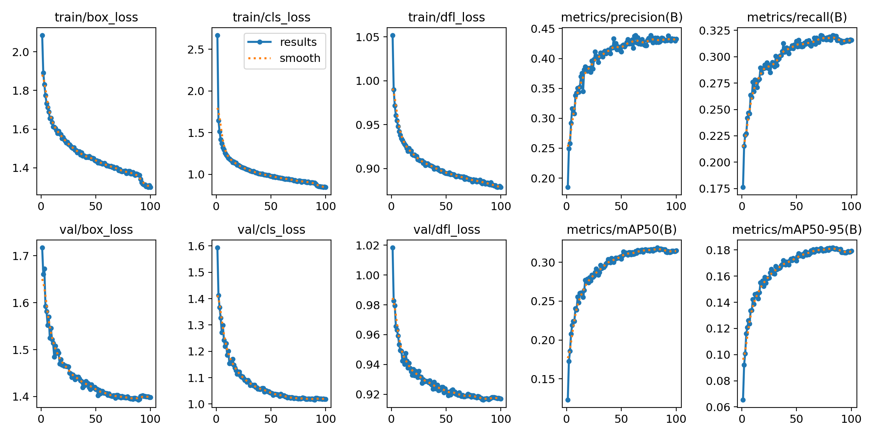
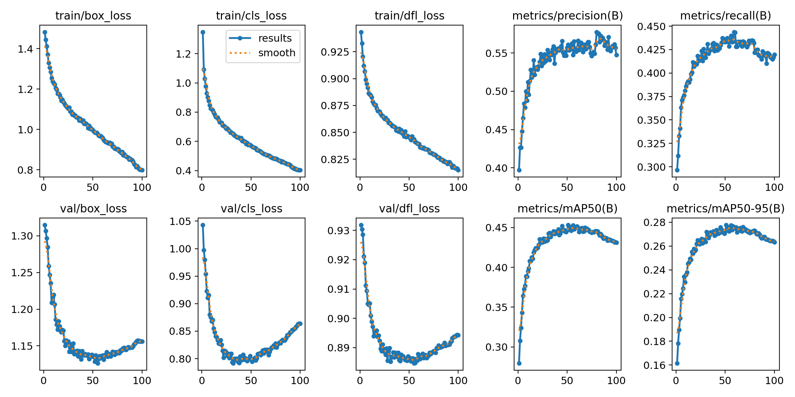
Methods—Yolov8
Object category | Bounding box centre point X | Bounding box centre point Y | Bounding box width | Bounding box height
4 | 0.467708 | 0.57222 | 0.028125 | 0.085185
YOLOv8 needs input txt. to be in the form
After 100 epochs training, the results are:
yolov8n
yolov8x
Presenter: Zhaoyu Yan (z5452207)
Notes:
For the training process,
YOLOv8’s input txt dataset should be in this form. It should include only five data for each line.
Specially, these two data are the coordinates of the bounding box’s center point, not the left corner coordinates.
After 100 epochs training, the results are shown here. For yolov8n, the model convergent, but for yolov8x, it still not. But we can see the performance is already much better than yolov8n.

Slide 19
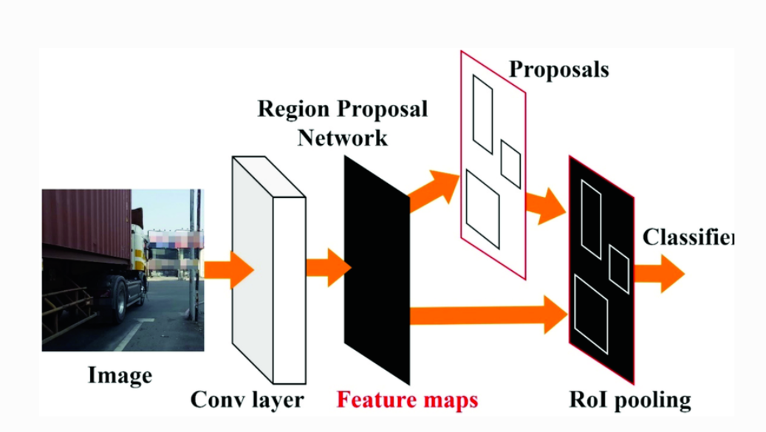
Method – Faster Rcnn Model
Two-stage object detection:
balance of accuracy and speed.
Steps:
Input image
Feature Extraction (ResNet)
RPN for region proposals
ROI Pooling
Classification & Bounding Box Regression
Presenter: Jiayang Jiang (z5319476)
Notes:
Presenter: Jiayang Jiang(z5319476) a two-stage object detection model known for balancing accuracy and speed. The process begins with an input image that passes through a backbone network, such as ResNet, to extract features. These features are then fed to a Region Proposal Network (RPN), which generates candidate regions that may contain objects. These regions of interest are then unified in size using ROI Pooling, allowing consistent processing by the classifier and bounding box regressor to determine the object category and its location. This pipeline ensures that Faster R-CNN achieves both high detection accuracy and precise localization.

Slide 20
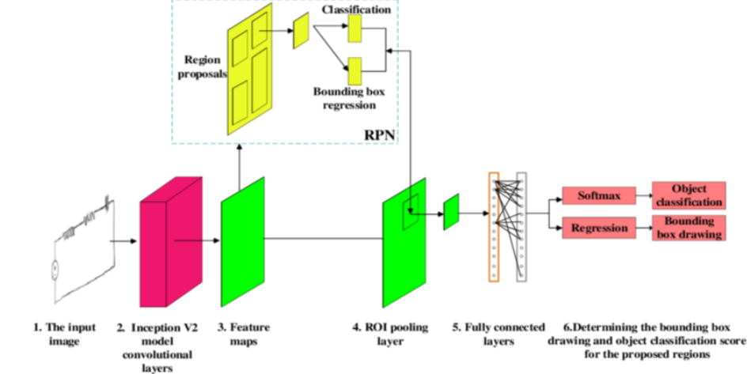
Method – Fast Rcnn Model
Key Components:
Backbone: ResNet for features.
RPN: Proposes regions.
ROI Pooling: Standardizes size.
Training Details:
Loss: Classification & regression.
Optimizer: SGD, learning rate 0.005.
Augmentation: Cropping, flipping, color adjustment.
Pros & Cons:
Pros: High accuracy.
Cons: Slower than YOLO.
Presenter: Jiayang Jiang(z5319476)

Slide 21
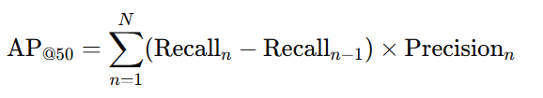
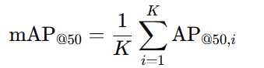
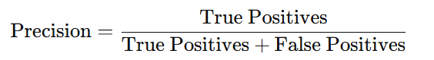
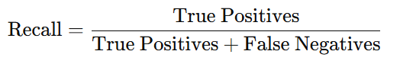
Results
Model | mAP@50 | Precision | Recall
YOLOv8 | 0.43 | 0.57 | 0.41
SSD | 0.23 | 0.36 | 0.43
Faster R-CNN | 0.28 | 0.49 | 0.38
Presenter: Jiayang Jiang (z5319476)
Notes:
Presenter: Jiayang Jiang(z5319476) In this comparison of the three models—YOLOv8, SSD, and Faster R-CNN—we can see their different strengths:
YOLOv8 achieved the highest mAP@50 of 0.51 and the best recall at 0.61, making it a balanced choice between accuracy and detecting more objects.
SSD had the highest precision at 0.73, which means fewer false positives, but its recall was lower at 0.43, suggesting it missed some detections.
Faster R-CNN had moderate performance across all metrics, with an mAP@50 of 0.34, precision of 0.49, and recall of 0.38, indicating a trade-off between speed and accuracy.
Overall, YOLOv8 offers the best balance for both precision and recall, making it more suitable for this task compared to the other models."

Slide 22
Discussion
YOLOv8:
Strengths: Fast, balanced precision/recall, great for real-time
Weaknesses: Higher false positives in complex scenes.
SSD:
Strengths: Efficient and quick with moderate accuracy.
Weaknesses: Prone to missing small or complex objects..
Faster R-CNN:
Strengths: Very accurate, good in complex scenes.
Weaknesses: Slow, unsuitable for real-time.
Presenter: Jiayang Jiang (z5319476)

Slide 23
Conclusion
Data preprocess:
Rearranged category attributes and filtered data for occlusion and balance.
Augmented underrepresented categories with Mosaic.
Finalized annotations and merged data for balanced category distribution
Model:
SSD: Fast, moderate accuracy.
Faster R-CNN: High accuracy, slow.
YOLO: Very fast, balanced, some false positives.
Proposed Improvements:
Model Ensemble: SSD refines YOLOv8.
Hyperparameter Tuning: Adjust learning rate.
Lightweight Faster R-CNN: Improve speed.
Best Result: YOLOv8
Presenter: Jiayang Jiang (z5319476)
Presenter: Jiayang Jiang(z5319476) "In comparing the three models, each has its own strengths and weaknesses. YOLOv8 stands out for its speed and balance between precision and recall, making it ideal for real-time tasks, though it has a slightly higher false positive rate compared to SSD. SSD excels in precision with fewer false positives, but its recall is lower, meaning it may miss detections. Faster R-CNN is highly accurate and performs well in complex scenes, but its slow inference makes it unsuitable for real-time use.
To improve performance, we propose several strategies: enhancing data augmentation with techniques like rotation and color jitter, using a model ensemble where SSD refines YOLOv8's outputs, tuning hyperparameters like the learning rate, and developing a lightweight version of Faster R-CNN to boost speed."

Slide 24

This Photo by Unknown Author is licensed under CC BY-SA

